Slide 1
The Post Correspondence Problem

Slide 2
Introduction to PCP
Post Correspondence Problem is a popular undecidable problem that was introduced by Emil Leon Post in 1946. It is simpler than Halting Problem.
In this problem we have N number of Dominos (tiles). The aim is to arrange tiles in such order that string made by Numerators is same as string made by Denominators. In simple words, lets assume we have two lists both containing N words, aim is to find out concatenation of these words in some sequence such that both lists yield same result.

Slide 3
Let’s try understanding this by taking two lists A and B
A=[aa, bb, abb] and B=[aab, ba, b]
Now for sequence 1, 2, 1, 3 first list will yield
aabbaaabb and second list will yield same string
aabbaaabb. So the solution to this PCP becomes 1, 2, 1, 3.
Post Correspondence Problems can be represented
in two ways:

Slide 4
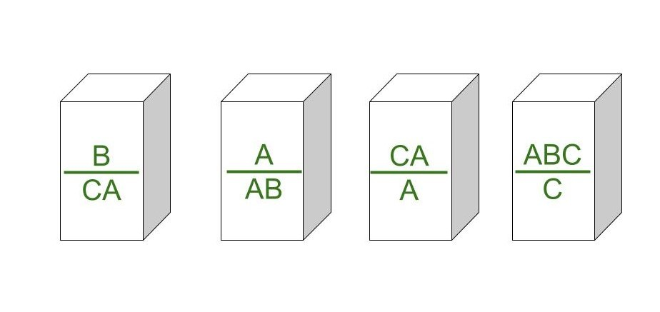
1. Domino’s Form :

Slide 5
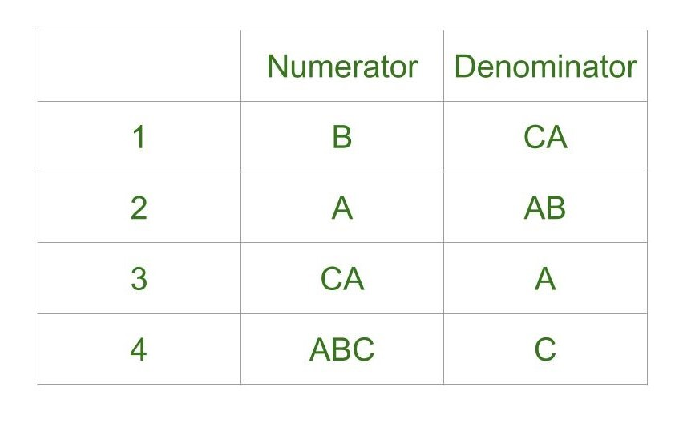
2. Table Form :

Slide 6
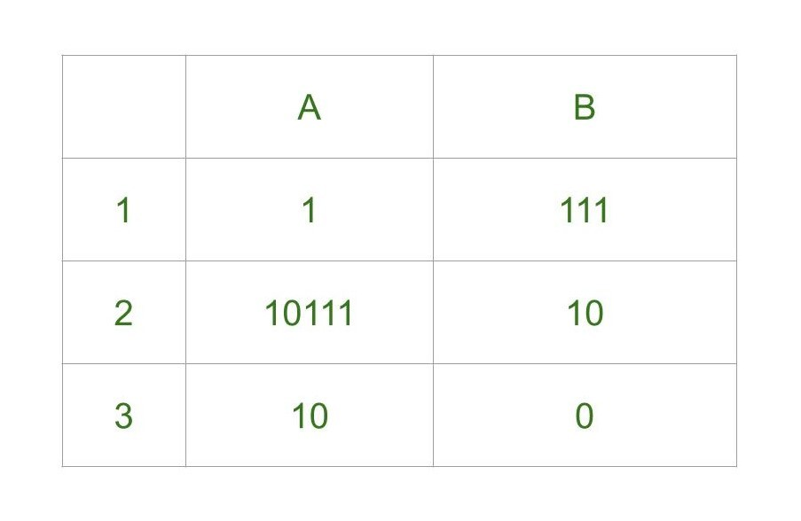
Example 1

Slide 7
Steps
Step-1: We will start with tile in which numerator and denominator are starting
with same number, so we can start with either 1 or 2. Lets go with second tile, string made by numerator- 10111,
string made by denominator is 10.
Step-2: We need 1s in denominator to match 1s in
numerator so we will go with first tile,
string made by numerator is 10111 1,
string made by denominator is 10 111.

Slide 8
Steps:
Step-3: There is extra 1 in numerator to match this 1 we will add first tile in sequence, string made by numerator is now 10111 1 1, string made by denominator is 10 111 111.
Step-4: Now there is extra 1 in denominator to match it we will add third tile, string made by numerator is 10111 1 1 10, string made by denominator is 10 111 111 0.Final Solution - 2 1 1 3 String made by numerators: 101111110 String made by denominators: 101111110
As you can see, strings are same.

Slide 9
Some undecidable problems for
context-free languages:
Is ?
are context-free grammars
Is context-free grammar ambiguous?

Slide 10
We need a tool to prove that the previous
problems for context-free languages
are undecidable:
The Post Correspondence Problem

Slide 11
The Post Correspondence Problem
Input:
Two sets of strings

Slide 12
There is a Post Correspondence Solution
if there is a sequence such that:
PC-solution:
Indices may be repeated or omitted

Slide 13
Example:
PC-solution:

Slide 14
Example:
There is no solution
Because total length of strings from
is smaller than total length of strings from

Slide 15
The Modified Post Correspondence Problem
Inputs:
MPC-solution:

Slide 16
Example:
MPC-solution:

Slide 17
We will show:
1. The MPC problem is undecidable
(by reducing the membership to MPC)
2. The PC problem is undecidable
(by reducing MPC to PC)

Slide 18
Theorem: The MPC problem is undecidable
Proof: We will reduce the membership
problem to the MPC problem

Slide 19
Membership problem
Input: Turing machine
string
Question:
Undecidable

Slide 20
Membership problem
Input: unrestricted grammar
string
Question:
Undecidable

Slide 21
Suppose we have a decider for
the MPC problem
String Sequences
MPC solution?
YES
MPC problem
decider
NO

Slide 22
We will build a decider for
the membership problem
YES
Membership
problem
decider
NO

Slide 23
The reduction of the membership problem
to the MPC problem:
Membership problem decider
yes
yes
MPC problem
decider
no
no

Slide 24
We need to convert the input instance of
one problem to the other
Membership problem decider
yes
yes
MPC problem
decider
Reduction?
no
no

Slide 25
Reduction:
Convert grammar and string
to sets of strings and
Such that:
There is an MPC
solution for
generates

Slide 26
Grammar
: start variable
: special symbol
For every symbol
For every variable

Slide 27
Grammar
string
: special symbol
For every production

Slide 28
Example:
Grammar :
String

Slide 31
Grammar :

Slide 32
Derivation:

Slide 33
Derivation:

Slide 34
Derivation:

Slide 35
Derivation:

Slide 36
Derivation:

Slide 37
has an MPC-solution
if and only if

Slide 38
Membership problem decider
yes
yes
Construct
MPC problem
decider
no
no

Slide 39
Since the membership problem is undecidable,
The MPC problem is undecidable
END OF PROOF

Slide 40
Theorem: The PC problem is undecidable
Proof: We will reduce the MPC problem
to the PC problem

Slide 41
Suppose we have a decider for
the PC problem
String Sequences
PC solution?
YES
PC problem
decider
NO

Slide 42
We will build a decider for
the MPC problem
String Sequences
MPC solution?
YES
MPC problem
decider
NO

Slide 43
The reduction of the MPC problem
to the PC problem:
MPC problem decider
yes
yes
PC problem
decider
no
no

Slide 44
We need to convert the input instance of
one problem to the other
MPC problem decider
yes
yes
PC problem
decider
Reduction?
no
no

Slide 45
: input to the MPC problem
Translated to
: input to the PC problem

Slide 46
For each
replace
For each

Slide 47
PC-solution
Has to start with
These strings

Slide 48
PC-solution
MPC-solution

Slide 49
has a PC solution
if and only if
has an MPC solution

Slide 50
MPC problem decider
yes
yes
Construct
PC problem
decider
no
no

Slide 51
Since the MPC problem is undecidable,
The PC problem is undecidable
END OF PROOF

Slide 52
Some undecidable problems for
context-free languages:
Is ?
are context-free grammars
Is context-free grammar
ambiguous?
We reduce the PC problem to these problems

Slide 53
Theorem:
Let be context-free
grammars. It is undecidable
to determine if
(intersection problem)
Proof:
Reduce the PC problem to this
problem

Slide 54
Suppose we have a decider for the
intersection problem
Context-free
grammars
Empty-
interection
problem
decider
YES
NO

Slide 55
We will build a decider for
the PC problem
String Sequences
PC solution?
YES
PC problem
decider
NO

Slide 56
The reduction of the PC problem
to the empty-intersection problem:
PC problem decider
no
yes
Intersection
problem
decider
yes
no

Slide 57
We need to convert the input instance of
one problem to the other
PC problem decider
no
yes
Intersection
problem
decider
Reduction?
yes
no

Slide 58
Introduce new unique symbols:
Context-free grammar :
Context-free grammar :

Slide 59
has a PC solution
if and only if

Slide 60
Because are unique
There is a PC solution:

Slide 61
PC problem decider
no
yes
Construct
Context-Free
Grammars
Intersection
problem
decider
yes
no

Slide 62
Since PC is undecidable,
the Intersection problem is undecidable
END OF PROOF

Slide 63
Theorem:
For a context-free grammar ,
it is undecidable to determine
if G is ambiguous
Proof:
Reduce the PC problem
to this problem

Slide 64
PC problem decider
no
yes
Construct
Context-Free
Grammar
Ambiguous
problem
decider
yes
no

Slide 65
start variable of
start variable of
start variable of

Slide 66
has a PC solution
if and only if
if and only if
is ambiguous

Slide 67
Rice Theorem
Rice theorem states that any non-trivial semantic property of a language which is recognized by a Turing machine is undecidable. A property, P, is the language of all Turing machines that satisfy that property.

Slide 69
Formal Definition Rice Theorem
If P is a non-trivial property, and the language holding the property, L_{p} , is recognized by Turing machine M, then L_{p} = {<M> | L(M) ∈ P} is undecidable.

Slide 70
Description and Properties Rice Theorem
Property of languages, P, is simply a set of languages. If any language belongs to P (L ∈ P), it is said that L satisfies the property P.
A property is called to be trivial if either it is not satisfied by any recursively enumerable languages, or if it is satisfied by all recursively enumerable languages.

Slide 71
Description and Properties of Rice Theorem:
A non-trivial property is satisfied by some recursively enumerable languages and are not satisfied by others. Formally speaking, in a non-trivial property, where L ∈ P, both the following properties hold:

Slide 72
Properties of Rice Theorem:
Property 1 − There exists Turing Machines, M1 and M2 that recognize the same language, i.e. either ( <M1>, <M2> ∈ L ) or ( <M1>,<M2> ∉ L )
Property 2 − There exists Turing Machines M1 and M2, where M1 recognizes the language while M2 does not, i.e. <M1> ∈ L and <M2> ∉ L

Slide 73
Proof of Rice Theorem:
Suppose, a property P is non-trivial and φ ∈ P.
Since, P is non-trivial, at least one language satisfies P, i.e., L(M₀) ∈ P , ∋ Turing Machine M₀.

Slide 74
Proof: Rice Theorem
Let, w be an input in a particular instant and N is a Turing Machine which follows −
On input x
Run M on w
If M does not accept (or doesn't halt), then do not accept x (or do not halt)
If M accepts w then run M₀ on x. If M₀ accepts x, then accept x.

Slide 75
Proof Rice Theorem:
A function that maps an instance ATM = {<M,w>| M accepts input w} to a N such that
If M accepts w and N accepts the same language as M₀, Then L(M) = L(M₀) ∈ p
If M does not accept w and N accepts φ, Then L(N) = φ ∉ p
Since A_{TM} is undecidable and it can be reduced to Lp, Lp is also undecidable.

